Slide 1
CSC111
Introduction to Computer Science
Course Instructors:
Prof. B. S. Aribisala
Dr. U. C. Ogude
Department of Computer Science
Lagos State of University

Slide 2
Computer Hardware
Functional units of a Computer
Central Processing Unit (CPU)
Main Memory
Peripheral Units
Input Devices
Output Devices
Auxiliary Storage Devices
The hardware is divided into three areas or separate units for its operation:
Central Processing Unit (CPU) or Processor
Main Memory
Peripheral Units or Electrical Gadgets

Slide 3
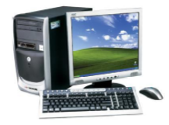
Computer Hardware
The hardware refers to the physical components or functional units of a computer which make up the computer configuration
The design and construction of the hardware of a particular computer is referred to as its architecture or configuration
The hardware components provide the physical interface to a computer system
What is hardware?
A program to process words
A physical component of a computer
A database of facts
A computer programming book

Slide 4
Functional Units of a Computer
The physical parts that make up a computer consists mainly of four basic units, these parts are known as hardware, namely:
input unit,
storage unit,
Central Processing Unit (CPU) or Processor
output unit.
Any hardware device connected to the computer or any part of the computer outside the CPU and the working memory is known as a Peripherals
Central Processing unit further includes Arithmetic logic unit and control unit, as shown in the Figure

Slide 5
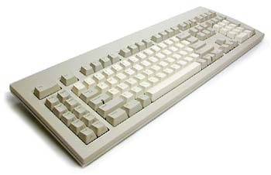
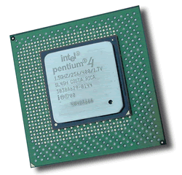
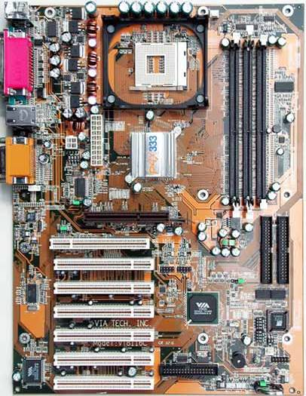
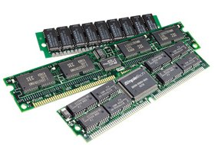
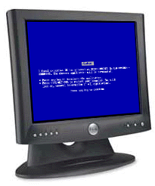
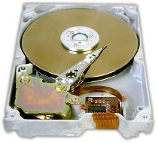
Hardware Organization
CPU
memory
motherboard
hard drive

Slide 6
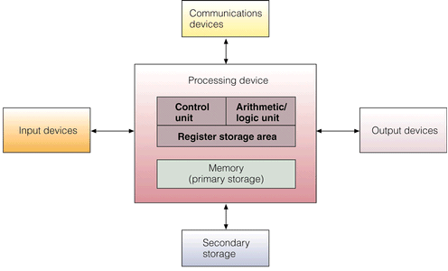
Hardware Components

Slide 7
Components of a Computer System
Central Processing Unit (CPU)
Data
control unit (CU)
Memory
output
units
Arithmetic
Logic Unit (ALU)
RAM
Input
units
ROM
Auxiliary
Memory
Information/Knowledge

Slide 8
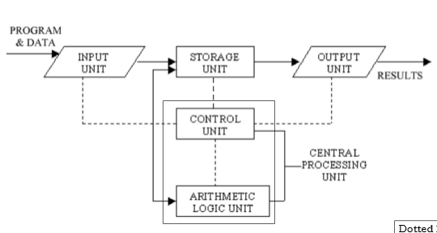

Functional units of a Computer

Slide 9
Functional Units of a Computer
A computer performs five major operations or functions irrespective of its size and make. These are
it accepts data or instructions as input,
it stores data and instruction
it processes data as per the instructions,
it controls all operations inside a computer, and
it gives results in the form of output.

Slide 10
Input and Output
The data or instructions you type into the computer are called input
The result of the computer processing your input is referred to as output
Peripheral devices accomplish input and output functions

Slide 11
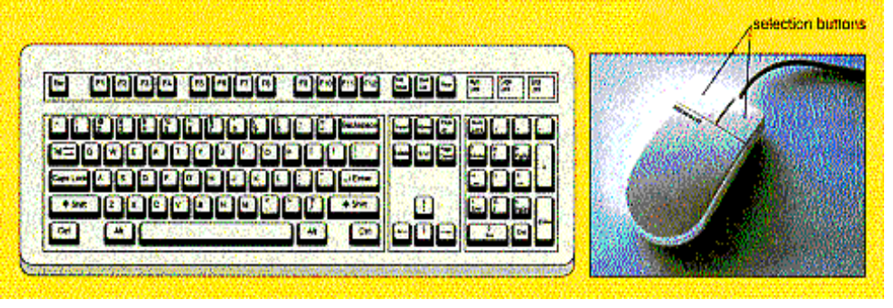
Input
Input unit – Input unit is a unit that accepts any input device. The input device is used to input data into the computer system
This unit is used for entering data and programs into the computer system by the user for processing.
Most common are keyboard and mouse
Function of input unit:
It converts inputted data into binary codes
It sends data to main memory of computer
Selector Buttons

Slide 12
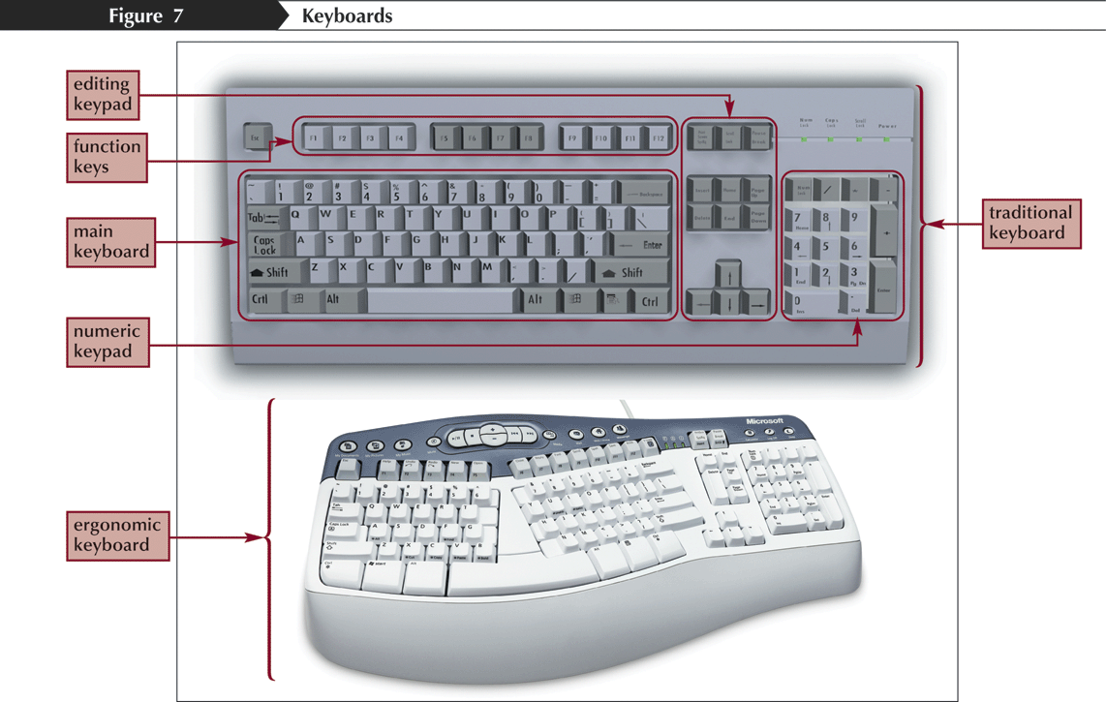
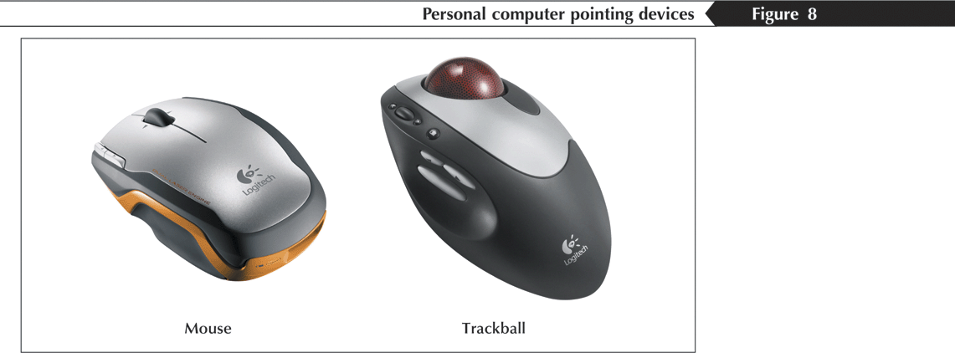
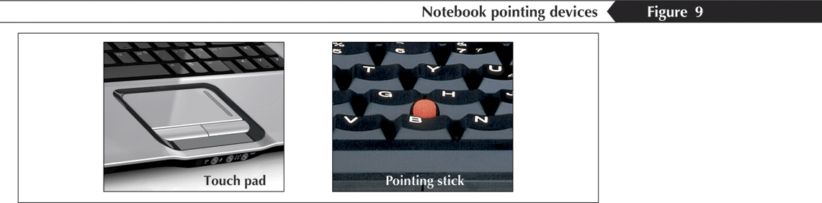
Input Devices
You use an input device, such as a keyboard or a mouse, to input data and issue commands
  Keyboard
    Ergonomic
  Pointing device
    Controls the pointer
    Mouse
      Scroll wheel
    Trackball
    Touch pad
    Pointing stick
  Scanner

Slide 13
Output
Output Unit –Output unit is a unit that constituents a number of output device. An output device is used to show the result of processing.
The output unit is used for storing the result as output produced by the computer after processing.
Function of Output unit:
it accepts data or information sends from main memory of computer
It converts binary coded information into HLL or inputted languages.

Slide 14
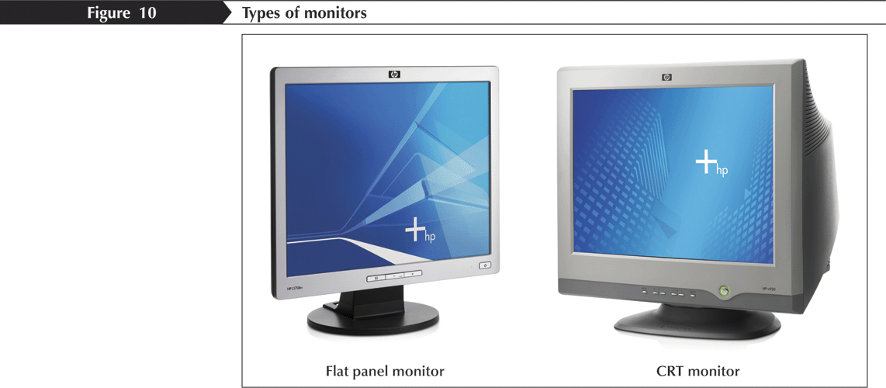
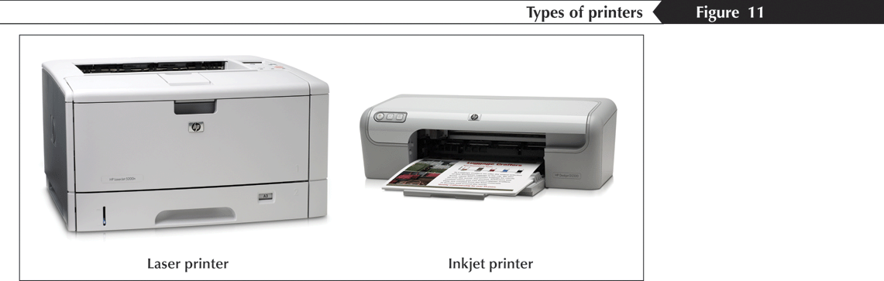
Output Devices
Output devices show you the results of processing data
  Monitor
    Flat panel
    LCD
    CRT
  Printer
    Laser
    Inkjet
    Dot matrix

Slide 15
Storage Unit
Storage Unit – The storage unit is used for storing data and instructions before and after processing

Slide 16
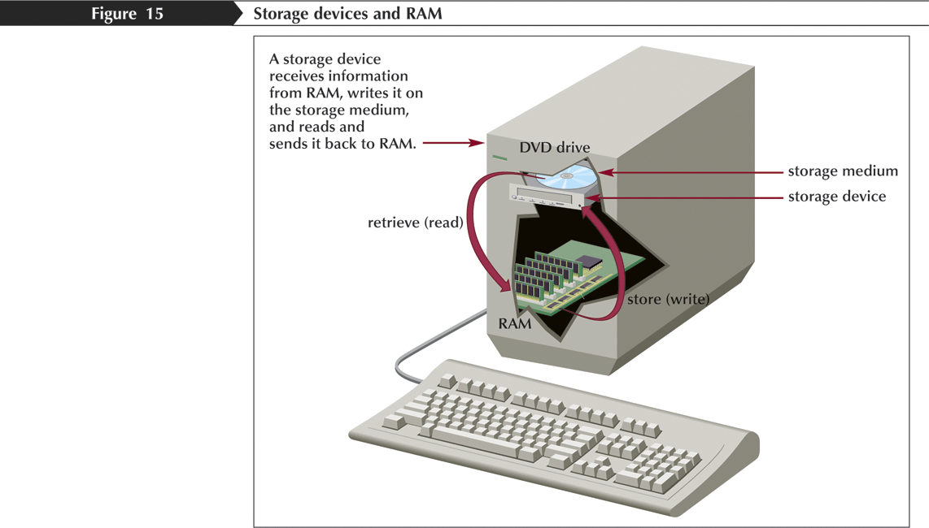
Storage Media
A computer file is a named collection of stored data
An executable file contains the instructions that tell a computer how to perform a specific task
A data file is created by a user

Slide 17
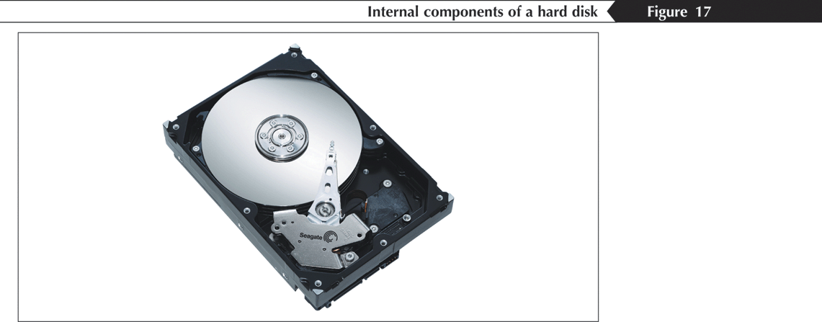
Storage Media
Magnetic media
  Hard disk
  Tape
  Floppy disk

Slide 18
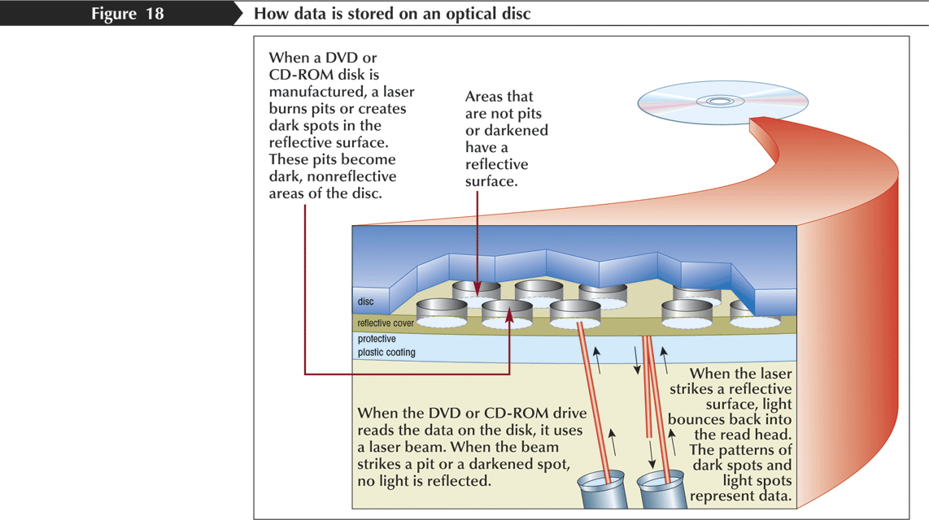
Storage Media
Optical storage device
  CD
  DVD
  CD-R
  CD-RW
  CD-ROM

Slide 19
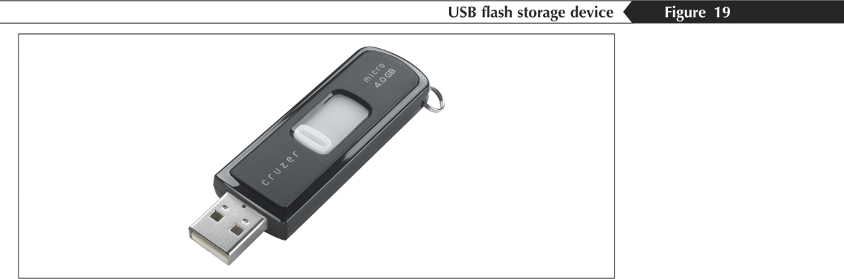
Storage Media
Flash memory
  Flash memory cards
  USB flash storage device
  USB drive (flash drive)

Slide 20
Central Processing Unit (CPU)
The task of performing operations like arithmetic and logical operations is called processing.
It takes data and instructions from the storage unit and makes all sorts of calculations based on the instructions given and the type of data provided. It is then sent back to the storage unit
Central Processing Unit (CPU) – CPU is called the brain of a computer.
An electronic circuitry that carries out the instruction given by a computer program.
CPU can be sub classified into three parts.
Control unit (CU)
Arithmetic & Logic unit (ALU)

Slide 21
Control Unit (CU)
Coordinates all activities of the computer by:
Determining which operations to perform and in what order to carry them out.
The CU transmits coordinating control signals to other computer components.
Controlling of all operations like input, processing and output are performed by control unit. It takes care of step by step processing of all operations inside the computer
the control unit manages the various components of the computer. It reads instructions from memory and interpretation and changes in a series of signals to activate other parts of the computer.
It controls and co-ordinate is input output memory and all other units.

Slide 22
Arithmetic & Logic Unit (ALU)
Consists of electronic circuitry to perform:
Arithmetic operations (addition, subtraction, multiplication and division)
Logical operations (and, or, not, …) and to make some comparisons (less-than, equal, … etc.)
All calculations and comparisons, based on the instructions provided, are carried out within the ALU.
It performs arithmetic functions like addition, subtraction, multiplication, division and also logical operations like greater than, less than and equal to etc
The arithmetic logic unit (ALU), which performs simple arithmetic operation such as +,-, *, / and logical operation such as >, <, =<, <= etc.

Slide 23
Function of CPU
It controls all the parts and software and data flow of computer.
It performs all operations.
It accepts data from input device.
It sends information to output device.
Executing programs stored in memory
It stores data either temporarily or permanent basis.
It performs arithmetical and logical operations.

Slide 24
Memory Unit (MU)
Memory is used to store data and instructions before and after processing.
Memory is also called Primary memory or internal memory. It is used to store data temporary or permanently.
Computer’s memory can be classified into two types;
primary memory and
secondary memory

Slide 25
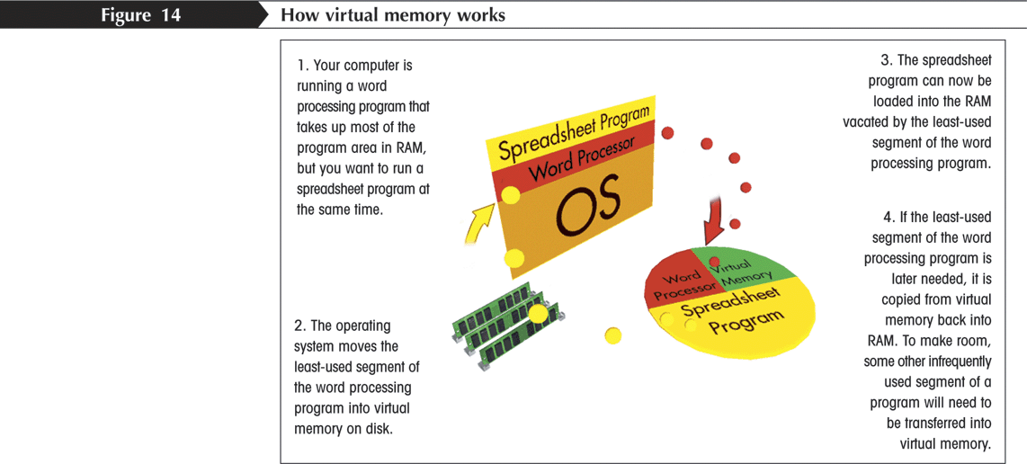
Memory
Random access memory (RAM)
  Volatile memory
  SDRAM
Cache memory (RAM cache or CPU cache)
Virtual memory

Slide 26
Memory
Read-only memory (ROM)
  BIOS
  Nonvolatile memory
Complementary metal oxide semiconductor memory (CMOS)
Semipermanent memory

Slide 27
Primary Memory
Also known as main memory.
Main memory is directly or indirectly connected to the central processing unit via a memory bus.
The CPU continuously reads instructions stored there and executes them as required.
Example:
– RAM
– ROM

Slide 28
Primary Memory
Primary Memory can be further classified as RAM and ROM.
RAM or Random Access Memory
It is the place in a computer where the operating system, application programs and the data in current use are kept temporarily so that they can be accessed by the computer’s processor.
It is said to be ‘volatile’ since its contents are accessible only as long as the computer is on.
The contents of RAM are no more available once the computer is turned off.
This is the part of the computer that stores operating system software, software applications and other information for the central processing unit (CPU) to have fast and direct access when needed to perform tasks.

Slide 29
ROM or Read Only Memory :
  Programmed at manufacturing time and contains manufacturer’s instructions.
  Its contents cannot be changed by users
  It is a permanent store
ROM or Read Only Memory is a special type of memory which can only be read and contents of which are not lost even when the computer is switched off.
ROM also stores an initial program called the ‘bootstrap loader’ whose function is to start the operation of computer system once the power is turned on.

Slide 30
Secondary Memory
Secondary/auxiliary memory is storage. It is not directly accessible by the CPU.
Computer usually uses its input/output channels to access secondary storage and transfers the desired data using intermediate area in primary storage.
Secondary storage devices are of two types;
Magnetic devices include hard disks and
Optical storage devices are CDs, DVDs, Pen drive, Zip drive etc.

Slide 31
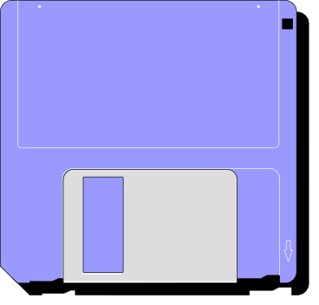
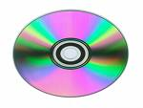
Secondary Storage
Stores data and programs permanently: its retained after the power is turned off
Examples
  Hard Drive (Hard Disk)
  Located outside the CPU, but most often contained in the system cabinet
  Floppy Disk
  Optical Laser Discs
    CD-ROM, CD-RW, and DVD

Slide 32
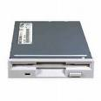
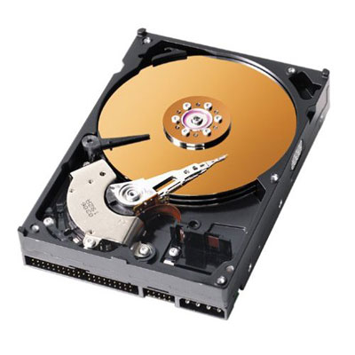
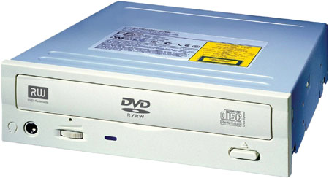
Kinds of Disk Drives

Slide 33
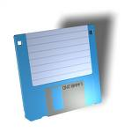
Common Secondary Media
Diskettes
  Data represented as magnetic spots on removable flexible plastic disks
  Most common size is 3 1/2 inches, in a rigid plastic case
  Disk drive holds the diskette, reads or retrieves the data and writes or stores data

Slide 34
Common Secondary Media
Hard drive
  Data is represented magnetically as with diskettes
  Normally more than one rigid platter in a sealed unit
  These disks are not removable
  Significantly more capacity and faster operating than diskettes

Slide 35
Optical Laser Discs
Common Secondary Media
CD ROM & DVD’s
    Data is represented as pits and lands
    Some kinds are read only (CD-ROM) and some Kinds are rewritable (CD-RW)
    Significantly more capacity and faster operating than diskettes
DVD: Digital Video Disk

Slide 36
Peripheral Units
  According to the most technical definition, the only pieces of a computer not considered to be peripherals are the central processing unit, power supply, motherboard, and computer case.
  A peripheral is a “device that is used to put information into or get information out of the computer. There are three different types of peripherals:
  i) Input
  ii) Output
  iii) Storage
A peripheral device is generally defined as any auxiliary device such as a computer mouse or keyboard, that connects to and works with the computer in some way.
Other examples of peripherals are expansion cards, graphics cards, image scanners, tape drives, microphones, loudspeakers, webcams, and digital cameras.
RAM—random access memory—straddles the line between peripheral and primary component; it is technically a storage peripheral, but is required for every major function of a modern computer and removing the RAM will effectively disable any modern machine.
Many new devices such as digital watches, smartphones and tablet computers have interfaces which allow them to be used as a peripheral by a full computer, though they are not host-dependent as other peripheral devices are.

Slide 37
Peripheral Units
Input Devices
In computing, an input device is a peripheral (piece of computer hardware equipment) used to provide data and control signals to an information processing system such as a computer or other information appliance. Examples of input devices include keyboards, mice, scanners, digital cameras and joysticks.
Output Devices
An output device is any piece of computer hardware equipment used to communicate the results of data processing carried out by an information processing system (such as a computer) which converts the electronically generated information into human-readable form.
Auxiliary Storage Devices
They are cheaper forms of storage that can store a lot of information until they are needed. They can also be called off-line storage media.

Slide 38
There are many types, but the most common types are magnetic disks and tapes. These are now available in many different varieties to facilities the needs of various types and size of computers, the volume of records to be held in backing storage, and data transfer speed requirement.
Common Peripherals
Input: Keyboard, Computer mouse, Graphic tablet, Touchscreen, Barcode reader, Image scanner, Microphone, Webcam, Game controller, Light pen, Scanner, Digital camera.
Output: Computer display, Printer, Projector, Speaker, Storage devices, Floppy disk drive, Flash drive, Disk drive, Smartphone or Tablet computer
Storage interface: CD/DVD drive, Input/Output, Modem, Network interface controller (NIC)

Slide 39
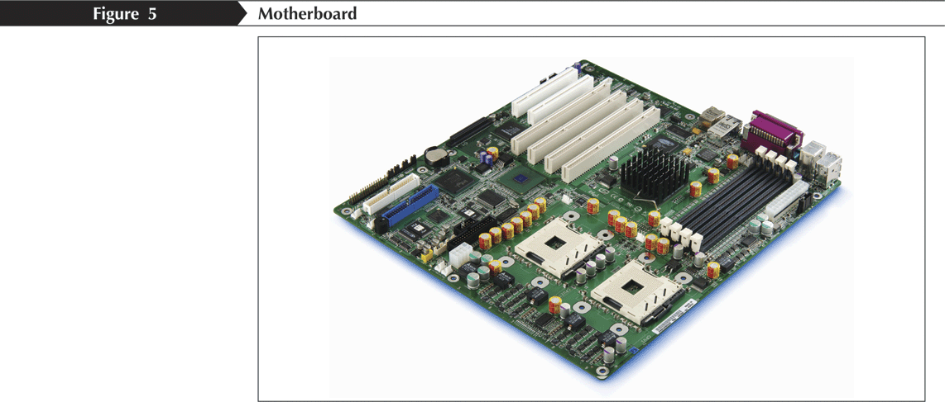
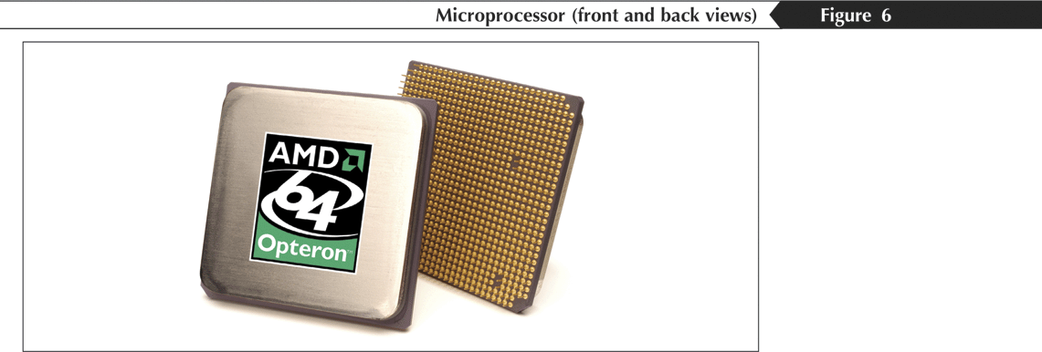
Processing Hardware
The motherboard is the main electronic component of the computer
  Circuit board
The microprocessor is one of the most important pieces of processing hardware on the motherboard
Cards are removable circuit boards

